Slide 1
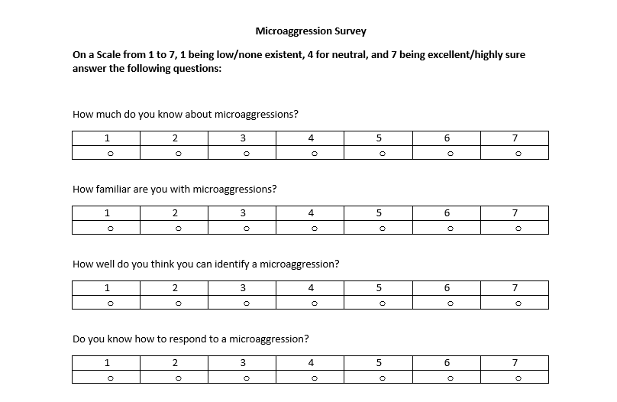
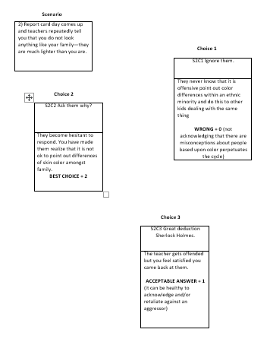
A Game-Based Learning Approach to Understanding and Identifying Microaggression
Najahwan Goode, Department of Behavioral Sciences
INTRODUCTION
DATA
RESULTS
“Microaggressions are everyday verbal, nonverbal, and environmental slights, snubs, or insults, whether intentional or unintentional, that communicate hostile, derogatory, or negative messages to target persons based solely upon marginalized group membership” (Sue 2010).
“These everyday occurrences may on the surface appear quite harmless, trivial, or be described as ‘small slights,’ but research indicates they have a powerful impact upon the psychological well-being of marginalized groups” (Sue 2010).
Some of the microaggressions studies that have been done include “The Taxonomy of Microaggressions; call for research”, “The identification of 5 domains related to the experience of Mas for Black people”. (Wong et al. 2010)
Two gaps in the field that I hoped to address was, how coping mechanisms mitigate the effects of MA and collecting some actual experimental data to work with.
My experiment was created to collect some quantitative data of microaggression. I also wanted to see if there is a difference in identifying and reacting healthy to microaggressions in individuals who have sustained controlled simulated experiences with microaggressions and those who don’t.
FIGURE 1. Shows the survey used by the participants before and after they played the game.
FIGURE 2. Shows one of the four scenarios the player was given, and the three choices they had to choose from. The scoring on these choices are not present in the scenarios given to the participants, they are on this copy to show how the game was scored.
Figure 3. This graph shows the average score of each player on all four survey questions before and after they played the game. 8 of the participants seem to have done better on the survey after playing the gam showing they gained some level of understanding of microaggression through their play through of the game and the debriefing afterwards. This sample size is not large enough to draw any conclusions but it is worth looking into further to see if repeated exposure to microaggressions can yield positively when trying to identify and react appropriately towards them.
FIGURE 1. This is a copy of the survey
given to each participant.
FIGURE 2. This is one pf the scenarios used I the experiment.
MATERIALS & METHODS
FIGURE 3. This is the data gathered from the experiment
For this experiment I had 15 subjects. The materials included cutout slips of paper folded in have that contained all the information for the game. In the top left corner of each paper was the location of the article within the game. These locations stated the scenario number and the choice number. Each individual took a Likert style survey before playing the game, and another after playing the game. The game consisted of four scenarios where the player was supposed to choose from three responses the response they felt would be best given each unique situation. An example of one of these scenarios follows in the data section. For the debriefing after the second survey I discussed with each player what their end score was and showed them what the most appropriate responses for each scenario was.
CONCLUSIONS
In conclusion, microaggressions are a very interesting new field of study aggressive behavior that should be further researched. This experiment tried to see if it would be possible to help people have more healthy responses to microaggression when dealing with them in a controlled setting. I would like t research this further in the future to come to a definitive answer on this question.
REFERENCES
Sue, D. W. (2010). Microaggressions and Marginality: Manifestation, Dynamics, and Impact. Jersey, NJ: John Wiley & Sons Inc.
Wong, G., Derthick, A. O., David, E. J., Saw, A., & Okazaki, S. (n.d.). The What, the Why, and the How: A Review of Racial Microaggression Research in Psychology. N.p.: 2010.

